Slide 1
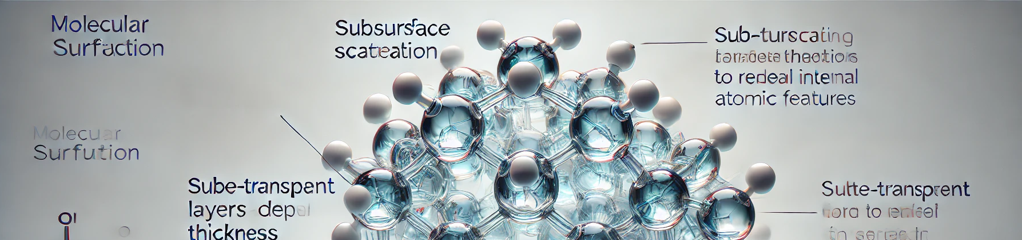
VU Visualisierung 2 (186.833) Rendering molecules for fun and profit Final Presentation
Yannic Ellhotka & Simon Wesp
11776184 & 11709457
Institute of Visual Computing & Human-Centered Technology, TU Wien, Austria
Notes:
< Exercise type> : 1. Research Paper Implementation​, 2. Technique Extension/Adaptation, 3. Dataset Visualization
In this template: 1. Research Paper Implementation​

Slide 2
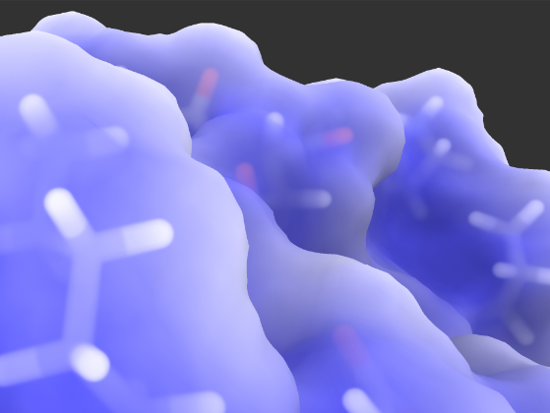
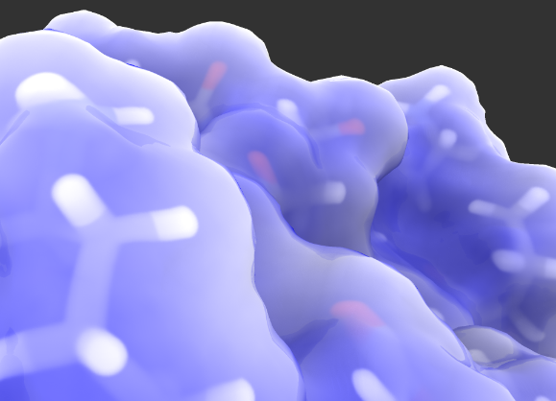
Short Article Summary
Displaying molecules is hard
Traditional methods inaccurate
Better visibility with
Subsurface scattering
Reflections and refractions
Transparency of internal structure
Visualization without reflections and refractions
Visualization with reflections and refractions
Notes:
Summarize the algorithms and concepts described in the paper.
If space is available, put some representative image here
~ 1 minute

Slide 3
Implementation
Rasterization of internal structure (balls and sticks)
Geometry
Instancing
Surface rendering with ray marching
Signed distance field calculated with a compute shader
Apply effects
1. Transparency
2. Subsurface scattering
3. Reflections
Notes:
Describe what you plan to implement – you do not need to and often should not stick 100% to the algorithm described in the paper.
If you do not stick closely to the paper, describe what you omit and / or what you will implement additionally.
The design and implementation effort should be proportional to the lab ECTS! Take existing libraries and online examples into account when estimating your effort!
If you have any open questions, put them here!
~1 minute

Slide 4
Implementation & Data
WebGPU
Typescript
SvelteKit
RCSB PDB
Notes:
Describe how you plan to implement the work: which visualization or graphics libraries do you plan to use?
Do you have some data already? Describe the relevant aspects of the data (source, size, structure etc.)!
Which data preprocessing steps are necessary and which libraries do you plan to use?
If you do not have data yet, this is a good time to get feedback!
~1 minute

Slide 5
Implementation & Data
2 Render Passes + Blending
Rasterization
Ray marching
Mini WebGPU Framework
Notes:
Describe how you plan to implement the work: which visualization or graphics libraries do you plan to use?
Do you have some data already? Describe the relevant aspects of the data (source, size, structure etc.)!
Which data preprocessing steps are necessary and which libraries do you plan to use?
If you do not have data yet, this is a good time to get feedback!
~1 minute

Slide 6
Challenges
WebGPU support and implementation varies a lot
Debugging shaders
Optimization - rendering 100k+ objects
Memory layout & management
Protein files invalid
Notes:
Describe how you plan to implement the work: which visualization or graphics libraries do you plan to use?
Do you have some data already? Describe the relevant aspects of the data (source, size, structure etc.)!
Which data preprocessing steps are necessary and which libraries do you plan to use?
If you do not have data yet, this is a good time to get feedback!
~1 minute

Slide 7
Demo
Demo :)
Notes:
Describe how you plan to implement the work: which visualization or graphics libraries do you plan to use?
Do you have some data already? Describe the relevant aspects of the data (source, size, structure etc.)!
Which data preprocessing steps are necessary and which libraries do you plan to use?
If you do not have data yet, this is a good time to get feedback!
~1 minute

Slide 8
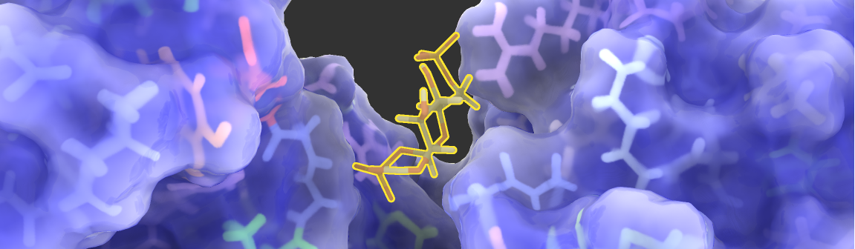
Rendering molecules for fun and profit
P. Hermosilla and S. Maisch and P.-P. Vázquez and T. Ropinski
Improving Perception of Molecular Surface Visualizations
Eurographics Workshop on Visual Computing for Biology and Medicine, 2018
Notes:
This is the last slide that remains visible until the next group comes up.
A picture would be helpful to support the discussion ☺
Nothing to say here.

